Slide 1









GeoXO Value Study: Trace Gas Emissions Updating
Chia-Hua Hsu, Daven K. Henze, Arthur P. Mizzi, Matthew S. Johnson, Jian He, Colin Harkins, Siyuan Wang, Congmeng Lyu, Rebecca Schwantes, Greg Frost, Katelyn O’Dell, Susan Anenberg, Kai Yang, Shobha Kondragunta, Brad Pierce, Gonzalo González Abad, Aaron R. Naeger, Xiong Liu, Christopher C. Miller, Brian C. McDonald

Slide 2
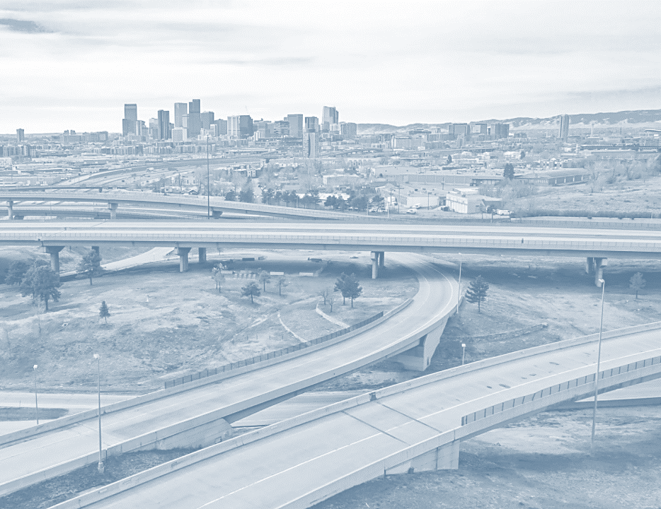
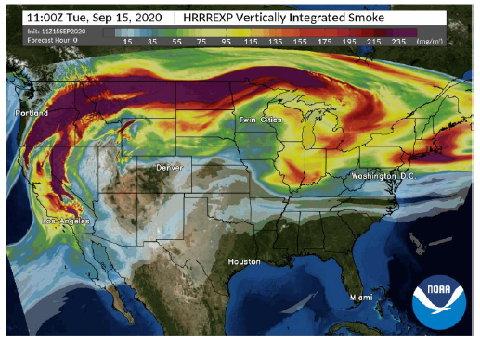
What is the need for near real-time updating of emissions?
Capture rapid changes
in human activity
Improve AQ forecasting
of wildfire emissions
Photo: Eric English
Source: www.thedenverchannel.com 2020/03/31

Slide 3
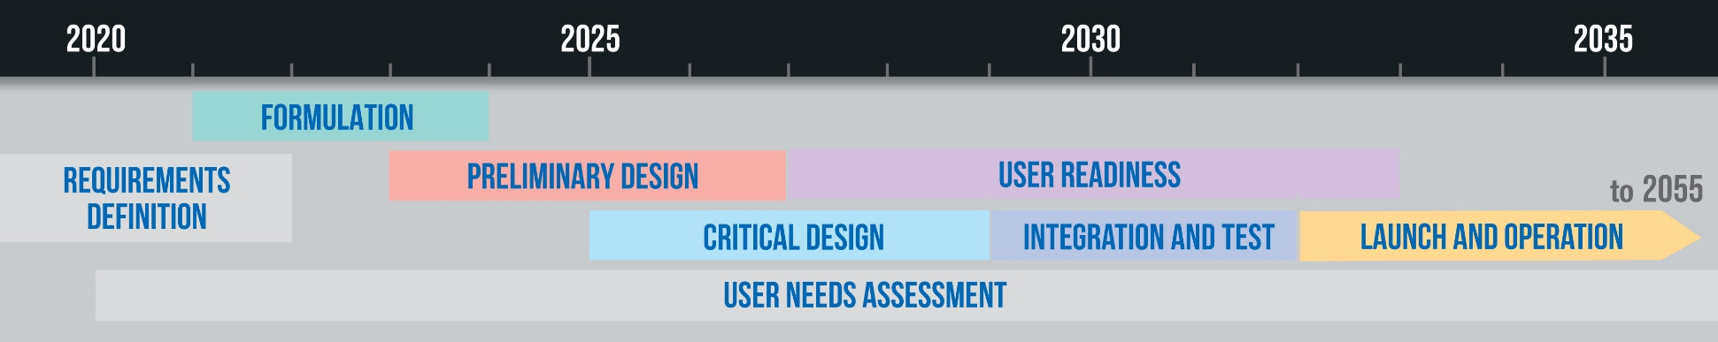
Research Objectives
Perform Observing System Simulation Experiment (OSSE) to demonstrate value of NO_{x} emissions updating using synthetic TEMPO NO₂
Perform OSSE to demonstrate value of improving wildfire emissions estimation and plume-rise using synthetic TEMPO AOD and ALH

Slide 4
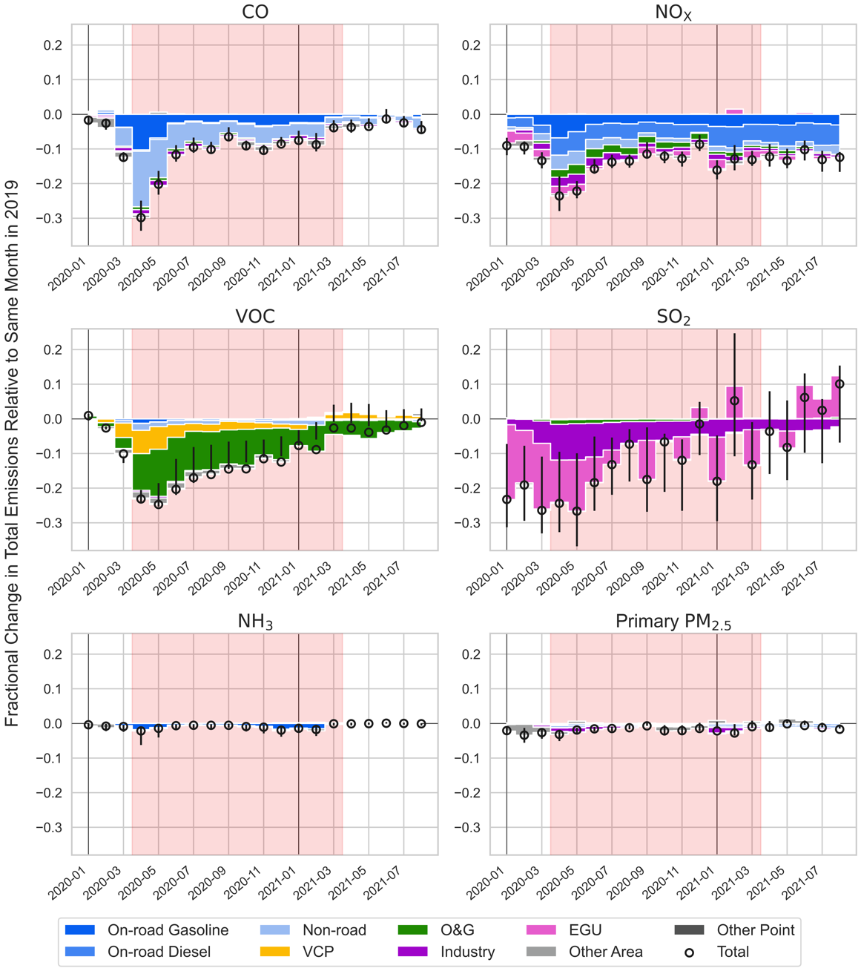

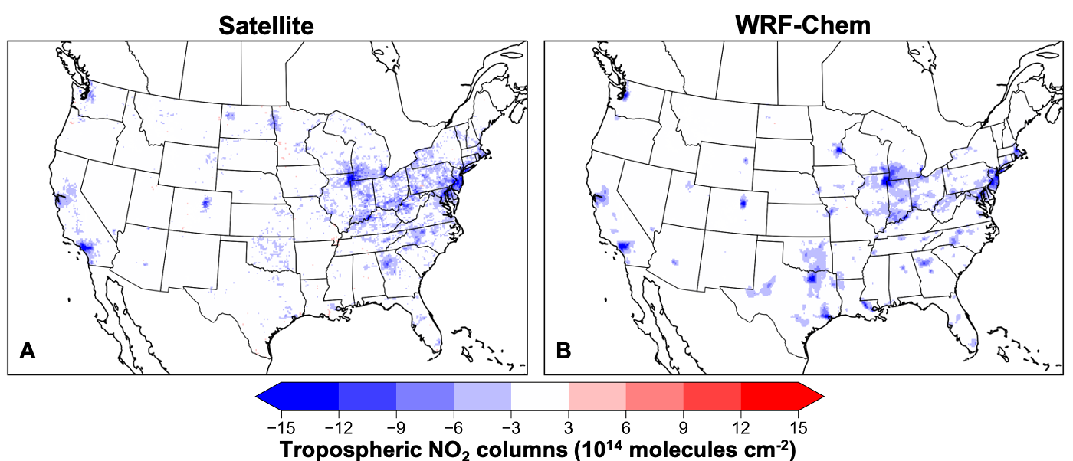

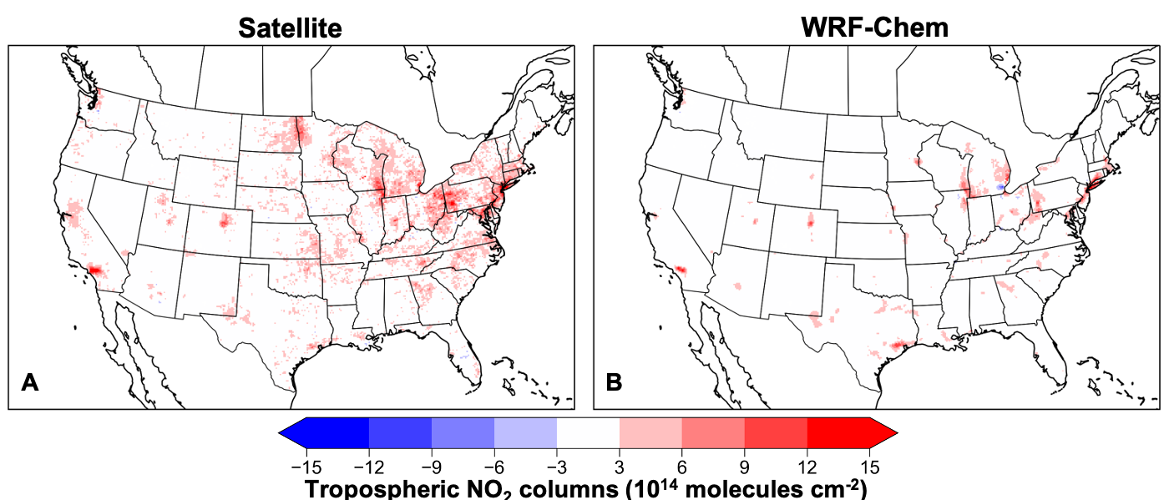
Developing a NRT Bottom-Up Emissions Inventory
of COVID-19
2019 → 2020 Changes (Apr – Jul)
Jian He
(NOAA/CU)
2020 → 2021 Changes (Apr – Jul)
Colin Harkins
(NOAA/CU)
He et al. (submitted)

Slide 5
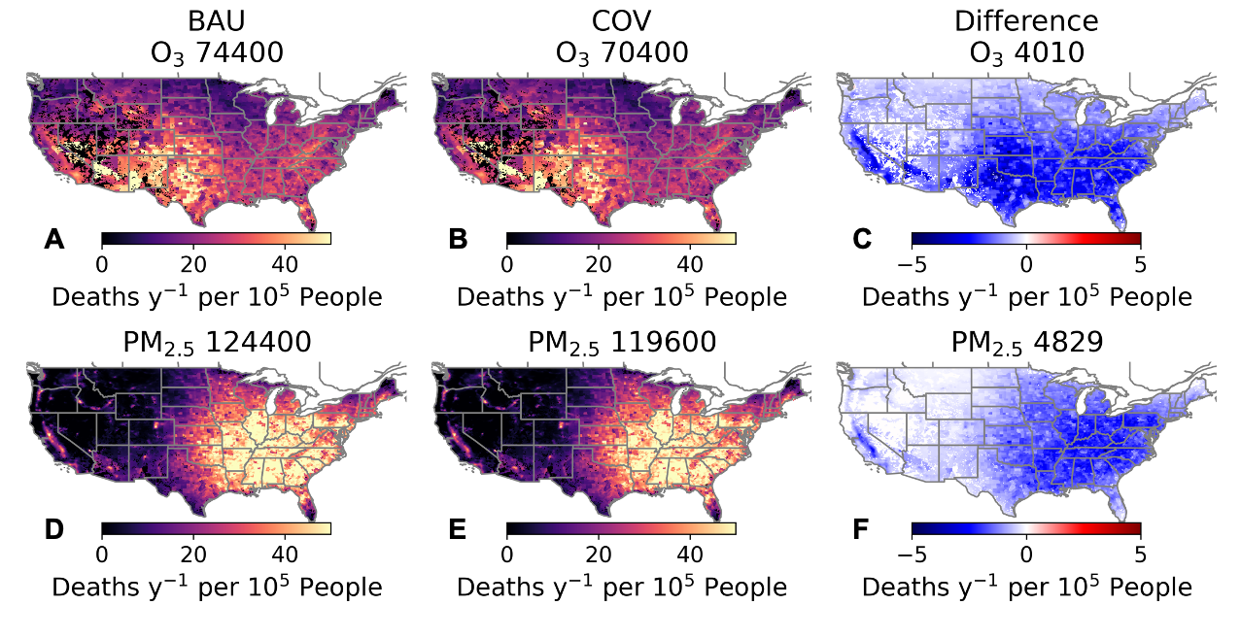


Health Impact Assessment of COVID-19 Pandemic
10-15% decrease in anthro. NO_{x} and VOC → 4-5% decrease in premature mortality due to air pollution
Katelyn O’Dell
(GWU)
Susan Anenberg
(GWU)
He et al. (submitted)

Slide 6
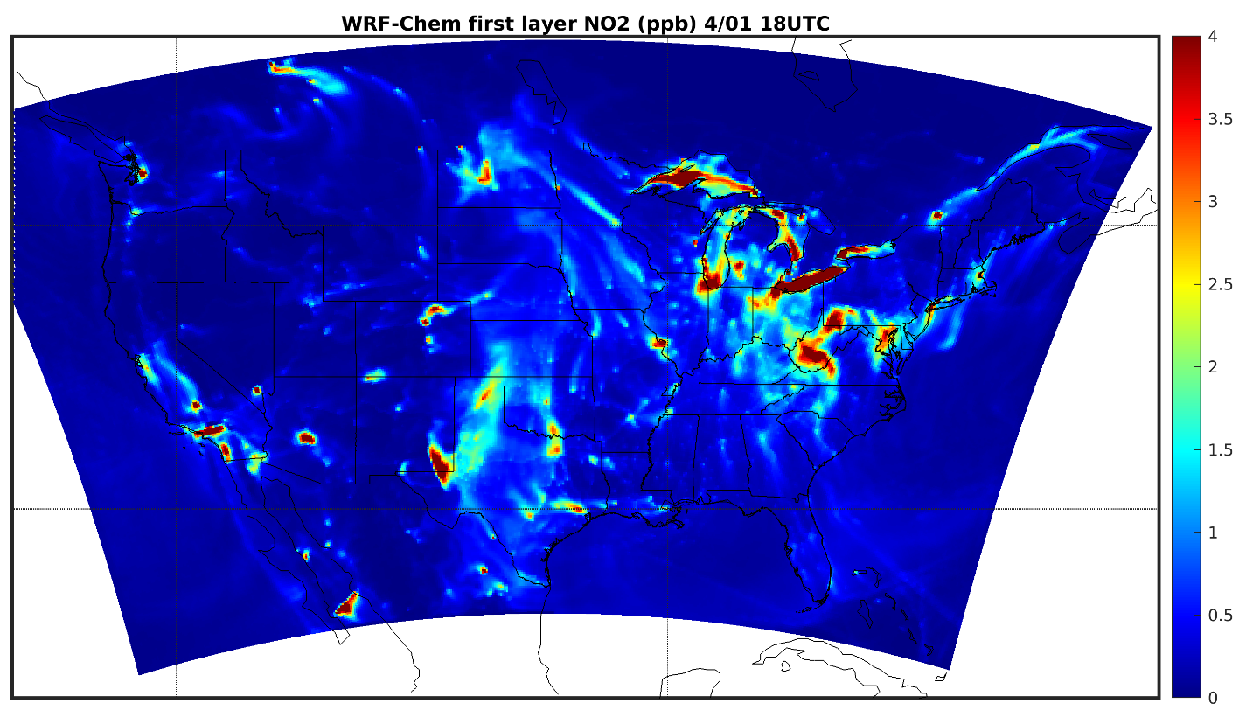
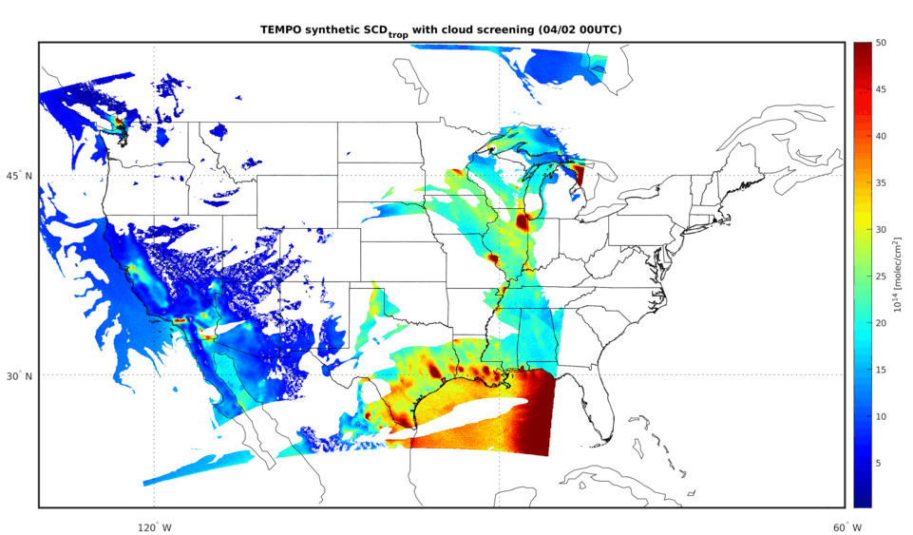

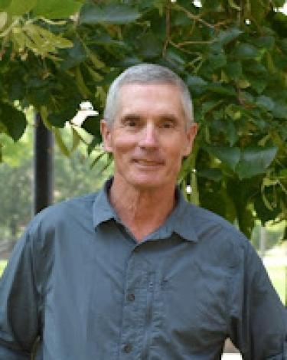
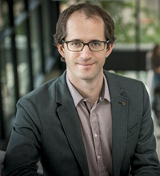
OSSE for NO_{x} Emissions Updating during
COVID-19 Pandemic
Simulate NO₂ w/ COVID-19 emissions in WRF-Chem (Nature Run)
Generated TEMPO Synthetic Data from WRF-Chem (12 km x 12 km)
Account for satellite geometry, instrument sensitivity, error characteristics, pixel resolution, sampling frequency
Chia-Hua Hsu
(NOAA/CU)
Arthur Mizzi
(NASA Ames)
Daven Henze
(CU)

Slide 7
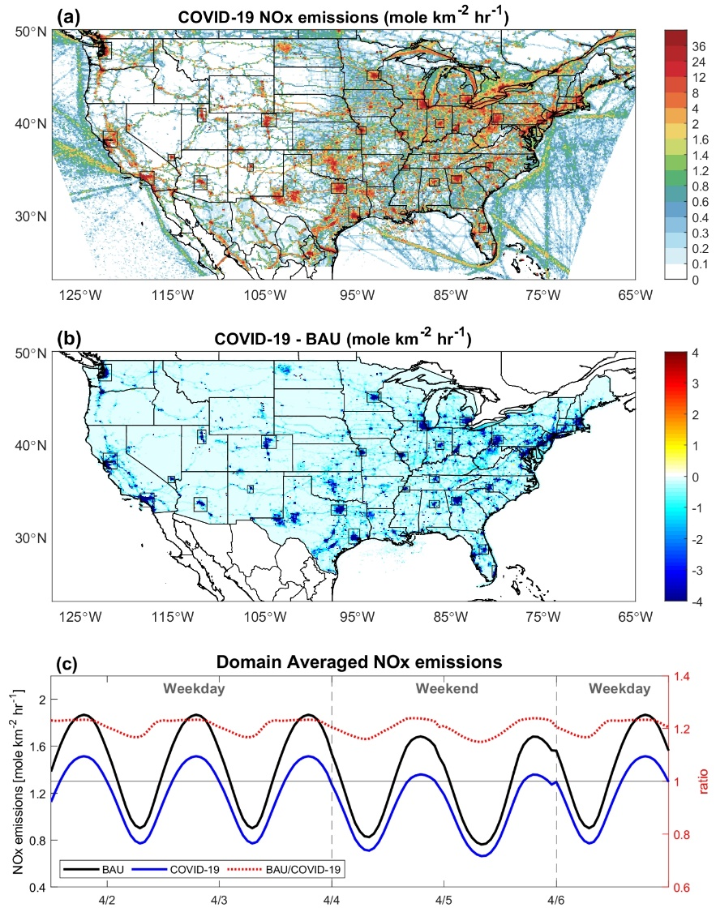
Model Design and Experimental Setup
WRF-Chem/DART (Mizzi et al. 2016)
Study period: April 1 – 6, 2020 (COVID-19 lockdowns)
Emission cases (BAU vs. COVID-19)
Synthetic TEMPO and TROPOMI NO₂
Data assimilation configuration
  3-hour DA cycle
  spatial data thinning (12x12 km)
Experiment | DA window (hours) | Hour (UTC) of OBS being assimilated | Update NOx concentration | Update NOx emissions | #OBS being assimilated
TEMPO-exp | 0 | 15, 18, 21, 00 | Yes | Yes | 752,091
TEMPO-exp1 | ±1.5 | 14 to 01 | Yes | Yes | 2,144,243
TEMPO-exp2 | ±1.5 | 15, 17-22, 00 | Yes | Yes | 1,697,575
TEMPO-EMS | 0 | 15, 18, 21, 00 | No | Yes | 752,091
TROPOMI-exp | ±1.5 | varies with each date | Yes | Yes | 330,261

Slide 8
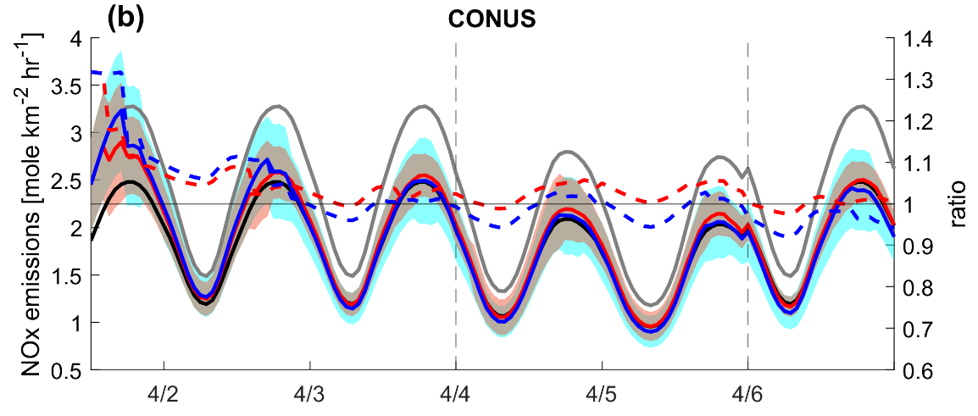
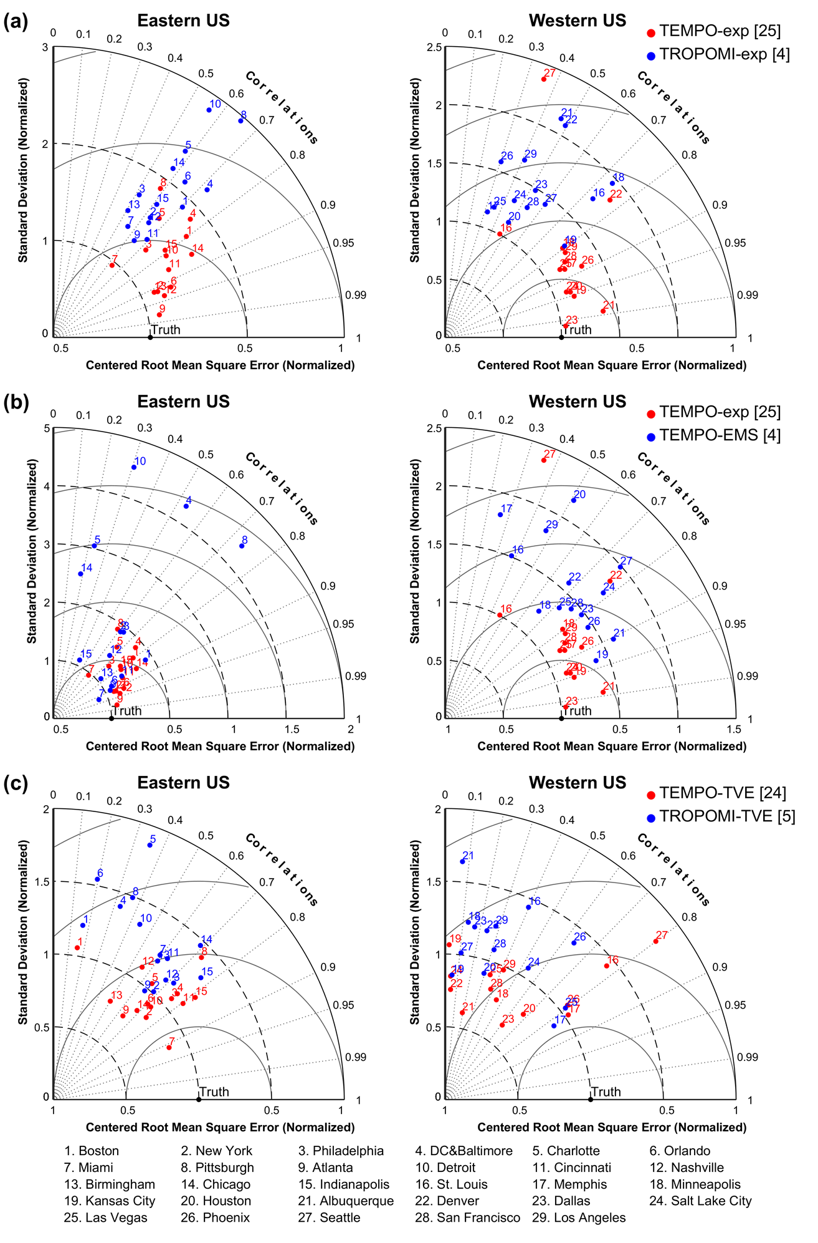
Benefit of Assimilating TEMPO versus TROPOMI NO₂
TEMPO recovers the true emissions at least twice as fast as TROPOMI
TEMPO-exp provides more accurate NO_{x} emissions estimates in most cities and regions

Slide 9
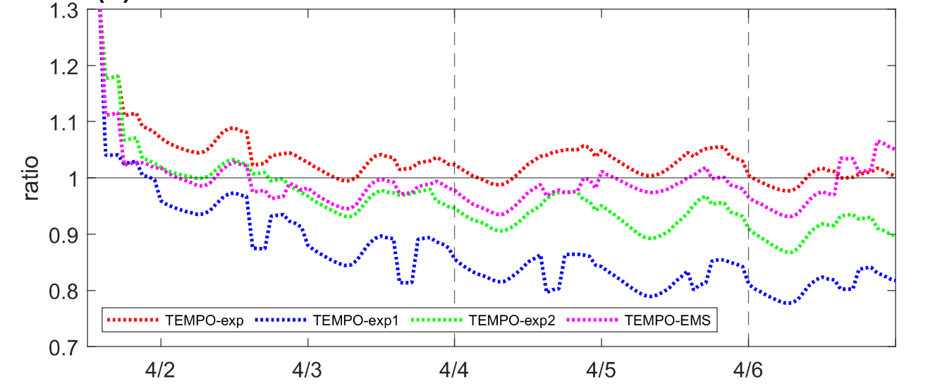
Extending DA Window Introduces Bias
into the Inversion
no
window
±1.5 h
all cycles
±1.5 h
18 & 21 UTC
only
no
window

Slide 10
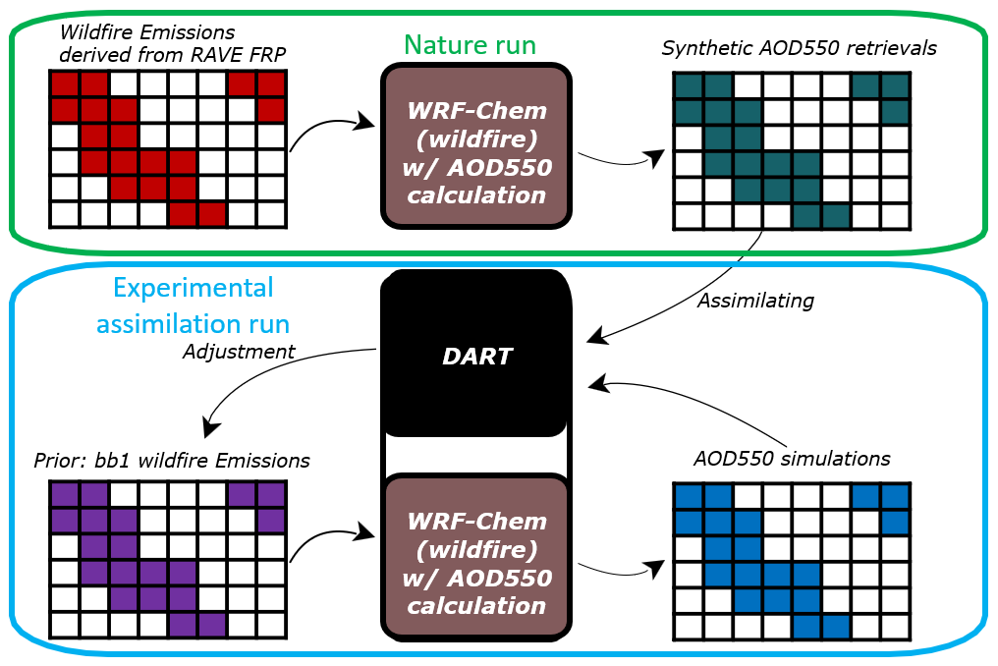


Design of Wildfire OSSE Experiment
Trammell Lyu
(NOAA/CU)
Siyuan Wang
(NOAA/CU)
Arthur Mizzi
(NASA Ames)

Slide 11
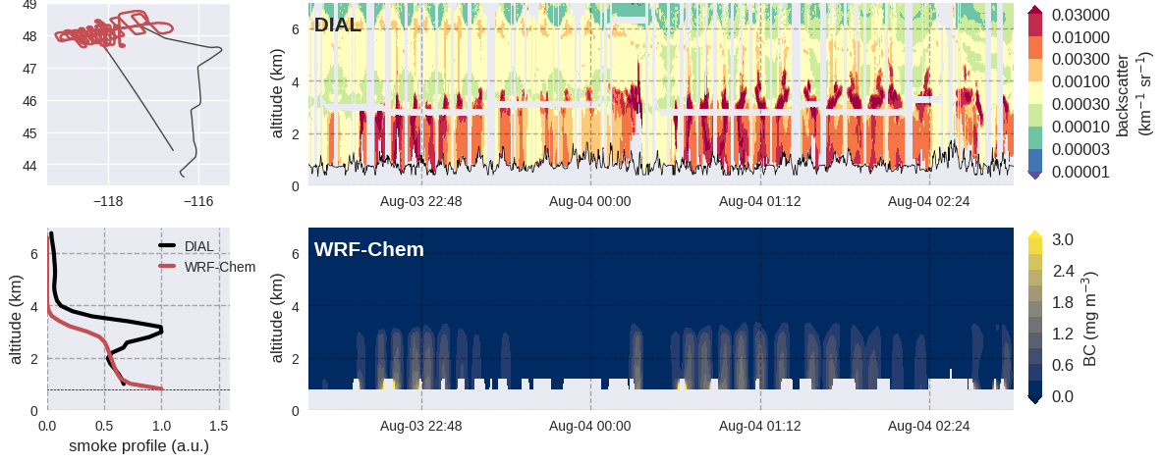
Evaluation of Model Nature Run with FIREX-AQ (Williams Flat)
Updated RAVE wildfire emissions (Li et al., RSE 2022) with FIREX-AQ derived emission factors

Slide 12
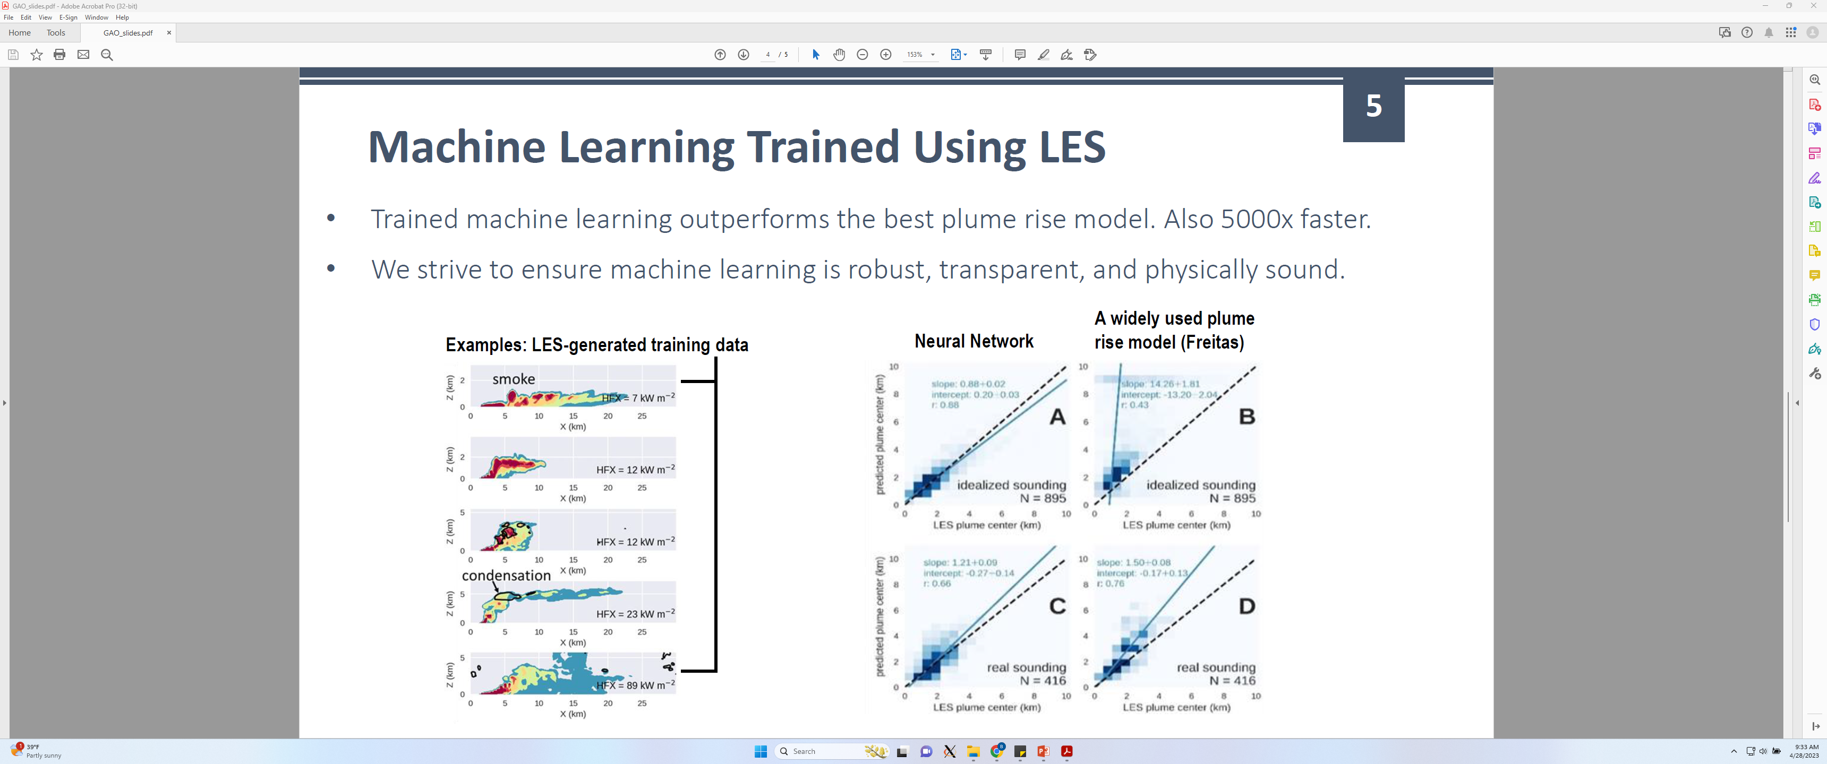
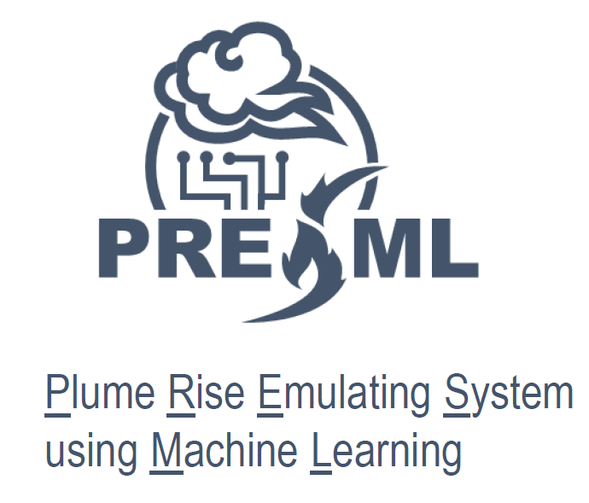
Plume-Rise w/ Machine Learning trained on
Large Eddy Simulations
Siyuan Wang
(NOAA/CU)

Slide 13
Summary
Best practices for constraining NOx emissions with TEMPO observations:
  Utilize short DA window to avoid representativeness errors
  Increase the frequency of assimilation cycling (e.g., 1 or 2 hours)
  Jointly constrain concentrations and emissions (when model errors exist)
  Future work: include HCHO and O₃ in OSSE, and perform real chemical data assimilation experiments with TROPOMI / TEMPO data
Perform OSSE to demonstrate value of improving wildfire emissions estimation and plume-rise using synthetic TEMPO AOD and ALH
  In addition to improving emissions estimation, need to improve plume-injection height
  Future work: Incorporate multiple smoke/aerosol layer height satellite products in addition to TEMPO, including MISR, TROPOMI/AOCH, GOES-16/17 Stereoscopic

